Slide 1

Vel Tech Rangarajan Dr. Sagunthala R&D Institute of Science and Technology
School of Computing
Department of Computer Science and Engineering
10211CS224 / FULL STACK APPLICATION DEVELOPMENT (JAVA)
PROJECT REVIEW : MILESTONE PROJECT – 2
Date: 20-04-2026
JOB PORTAL MANAGEMENT SYSTEM
SDG-9-Industry,Innovation, and infrastructure.
Presented By:
M.JAHNAVI SATYA– VTU25739 – 23UECS1078
Courses Handling Faculty:
Dr. S. HEMAMALINI, M.E., Ph.D.
Assistant Professor

Slide 2
INTRODUCTION
1
In today’s digital era, job searching and recruitment have become more important.
Many students face difficulty finding suitable job opportunities.
Employers often struggle to manage applications manually.
A centralized online platform is needed for both job seekers and employers.
The Job Portal Management System connects students and employers in one system.
Students can register, create profiles, upload resumes, and apply for jobs.
Employers can post jobs, view applicants, and shortlist candidates.
The project is developed using Spring Boot, Spring Security, Thymeleaf, and MySQL.
It provides a secure, efficient, and user-friendly recruitment solution.
2
3
4
5
6
7
8
9

Slide 3
PROBLEM STATEMENT
1
Traditional recruitment methods are slow and time-consuming.
Students need to search for jobs from multiple sources.
Employers face difficulty managing applications manually.
There is no centralized platform for job posting and hiring.
Tracking applications and candidate status becomes difficult.
Manual handling may lead to errors and delays.
Secure login and data protection are often missing.
Therefore, an automated and secure Job Portal system is required.
2
3
4
5
6
7
8
9

Slide 4
OBJECTIVE(S)
1
To develop a web-based Job Portal Management System.
To provide secure user registration and login facilities.
To allow students to create profiles and upload resumes.
To enable users to search and apply for jobs online.
To help employers post and manage job vacancies.
To provide applicant tracking and status updates.
To implement role-based access for Student, Employer, and Admin.
To reduce manual recruitment work and improve efficiency.
2
3
4
5
6
7
8
9

Slide 5
PROPOSED SYSTEM
1
Provides a centralized platform for job seekers and employers.
Allows students to register, login, and maintain profiles.
Enables resume upload and online job applications.
Supports job search with filters like category, location, and experience.
Allows employers to post, edit, and delete job vacancies.
Employers can view applicants and shortlist or reject candidates.
Admin can manage users, jobs, and applications.
Uses secure authentication with role-based access control.
Improves recruitment efficiency and reduces manual work.
2
3
4
5
6
7
8
9

Slide 6
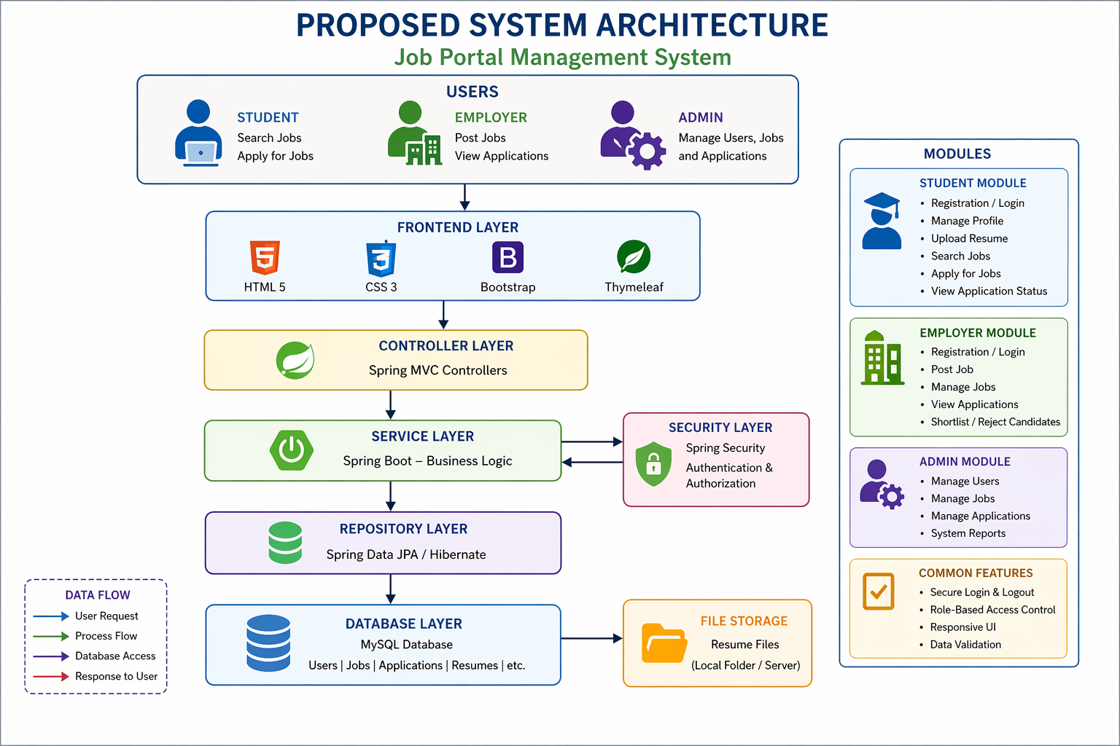
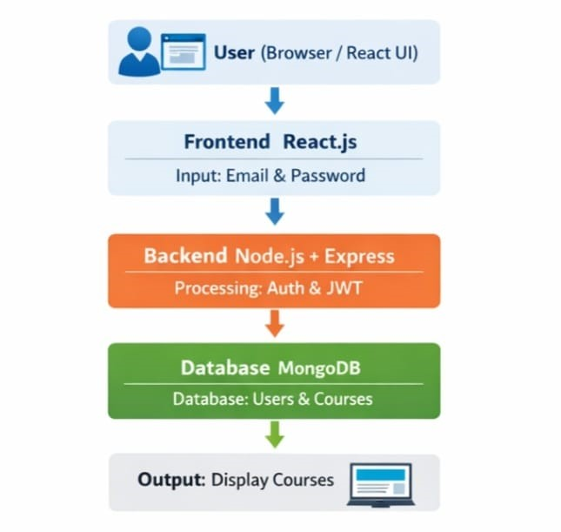
PROPOSED SYSTEM ARCHITECTURE
1
2
3
4
5a
6
7
8
9

Slide 7
PROPOSED SYSTEM ARCHITECTURE
1
Presentation Layer (Frontend): HTML5, CSS3, Bootstrap, Thymeleaf for user interface.
Application Layer (Backend): Spring Boot and Spring MVC handle business logic and request processing.
Security Layer: Spring Security provides authentication and role-based authorization.
Database Layer: MySQL stores users, jobs, applications, and resume details.
Modules Included: Student Module, Employer Module, Admin Module.
Data Flow: User Request → Controller → Service Layer → Repository → Database → Response to UI.
File Storage: Resume files stored in local folder or database path.
2
3
4
5b
6
7
8
9

Slide 8
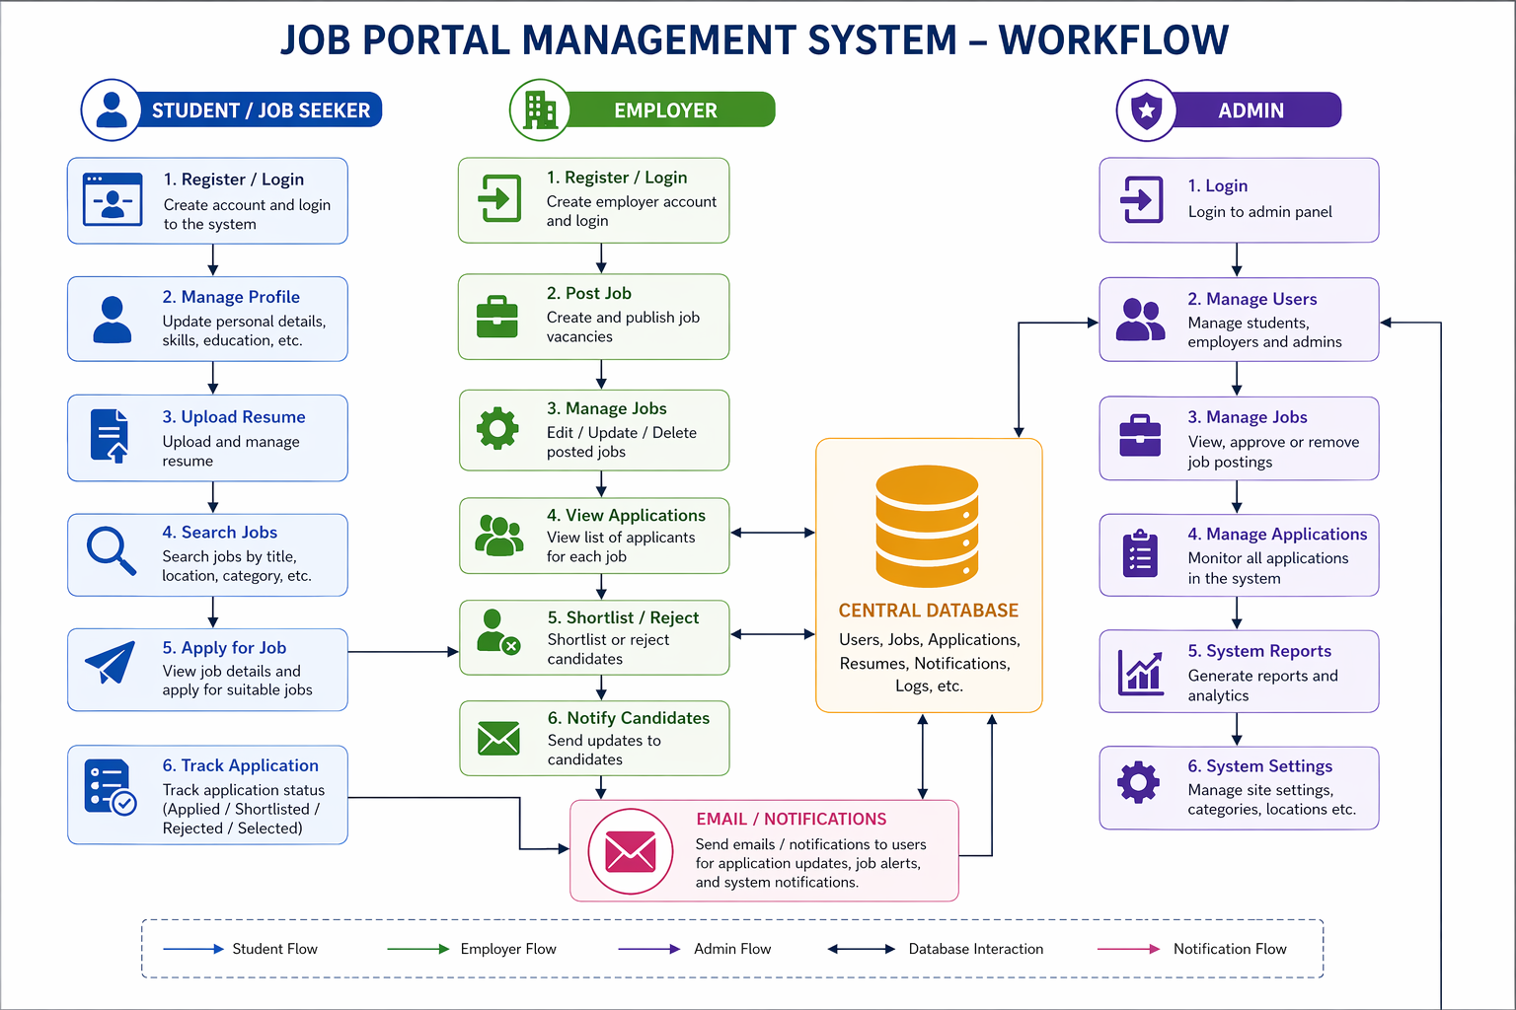
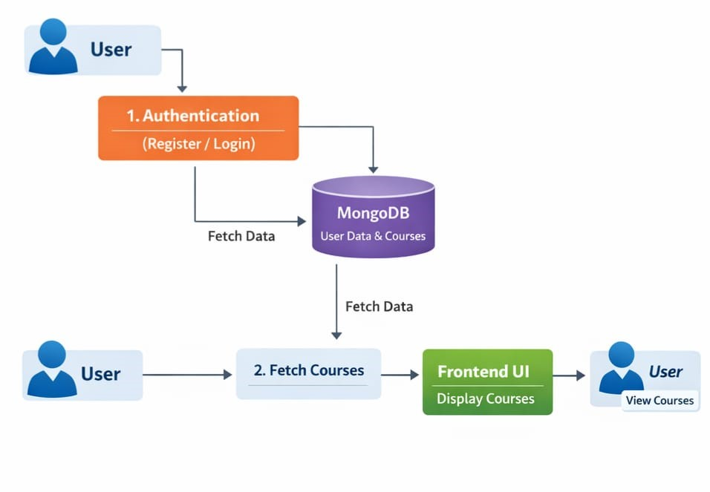
WORKFLOW
1
2
3
4
5
6
7
8
9

Slide 9
TECHNOLOGIES USED
Frontend Technologies
HTML5
CSS3
Bootstrap 5
JavaScript
Thymeleaf
Backend Technologies
Java 17
Spring Boot
Spring MVC
Spring Security
REST APIs
Database
MySQL
Tools & IDE
IntelliJ IDEA / VS Code / Eclipse
Maven
Postman
Git & GitHub
Server
Apache Tomcat (Embedded in Spring Boot)
1
2
3
4
5
6
7
8
9

Slide 10
MODULE DESCRIPTION
1
Module 1: User Management
Handles student, employer, and admin registration/login.
Manages user profiles and account details.
Provides secure authentication.
Module 2: Job Management
Employers can post new jobs.
Edit or delete job vacancies.
Manage job details like skills, salary, and location.
2
3
4
5
6
7
8a
9

Slide 11
MODULE DESCRIPTION
1
2
Module 3: Application Management
Students can apply for jobs online.
Tracks application status.
Employers can review applicants.
Module 4: Resume Management
Students upload resumes in PDF/DOC format.
Stores resume files securely.
Employers can view resumes.
3
4
5
6
7
8b
9

Slide 12
MODULE DESCRIPTION
1
Module 4: Resume Management
Students upload resumes in PDF/DOC format.
Stores resume files securely.
Employers can view resumes.
Module 6: Notification System
Sends job alerts and application updates.
Notifies shortlisted/rejected candidates.
2
3
4
5
6
7
8c
9

Slide 13
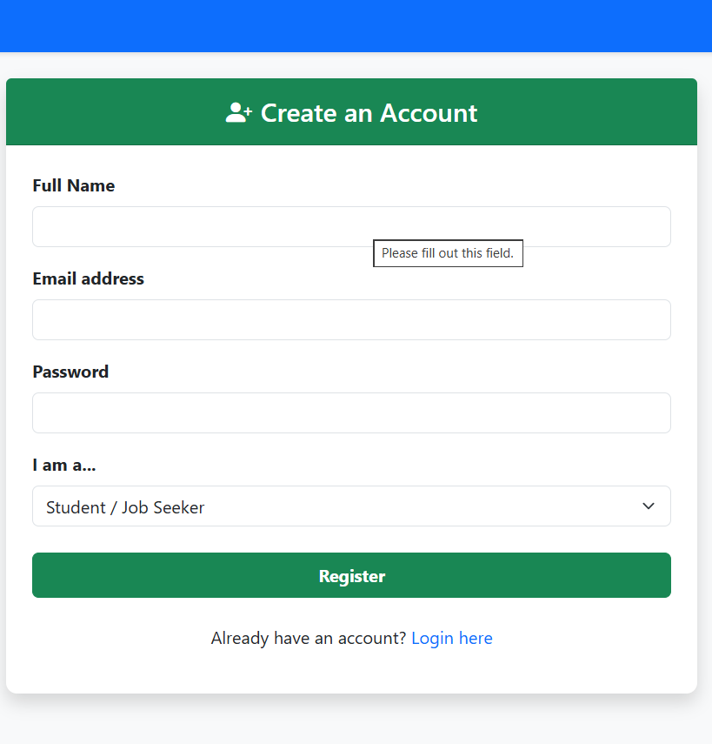
IMPLEMENTATION SCREENSHOTS
1
2
3
4
5
6
7
8
9a

Slide 14
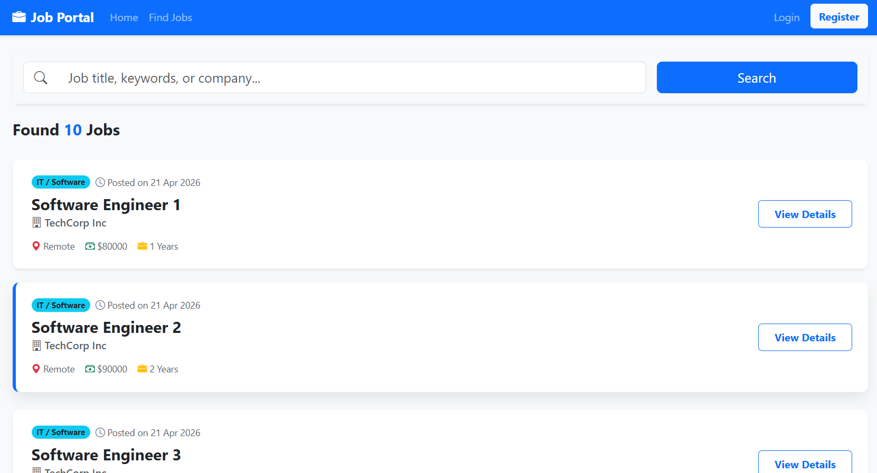
IMPLEMENTATION SCREENSHOTS
1
2
3
4
5
6
7
8
9b

Slide 15
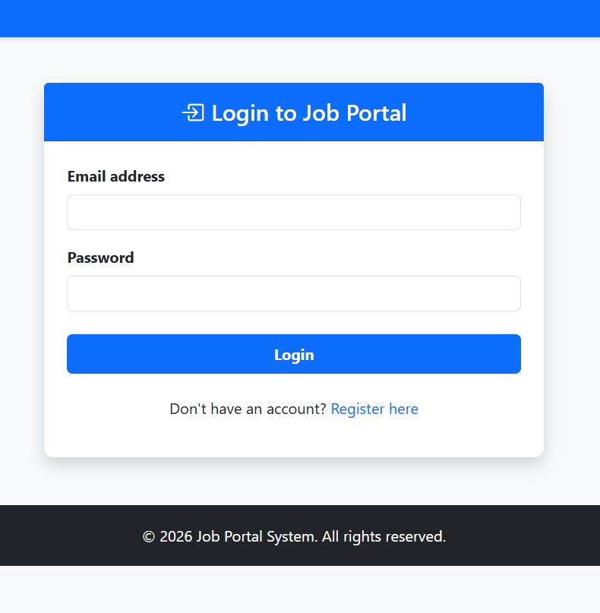
IMPLEMENTATION SCREENSHOTS
1
2
3
4
5
6
7
8
9c

Slide 16
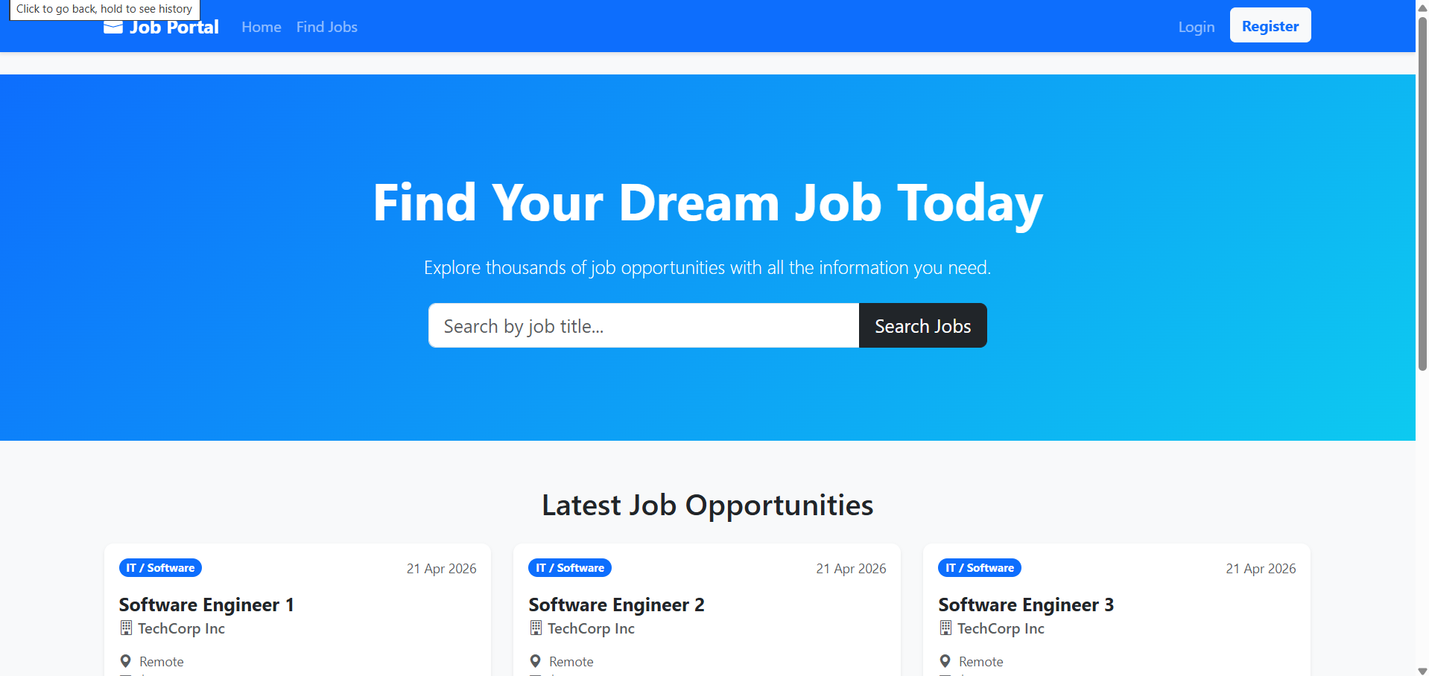
IMPLEMENTATION SCREENSHOTS
1
2
3
4
5
6
7
8
9d

Slide 17
ADVANTAGES & LIMITATIONS
1
Advantages
Provides a centralized platform for job seekers and employers.
Reduces manual recruitment work and saves time.
Secure login with role-based access control.
Easy job search with filters and online application system.
Resume upload and application tracking features.
Faster communication between employers and candidates.
User-friendly and scalable system.
Limitations
Requires internet connection to access the portal.
Initial version may have basic UI design.
No AI-based job recommendation in current system.
Email/SMS notification features may be limited.
Depends on regular database maintenance and updates.
2
3
4
5
6
7
8
9
10

Slide 18
Thank you

